Slide 1

Portfolio
T1A2 presentation

Slide 2
Morning All
Feel free to ask anything at any time

Slide 3
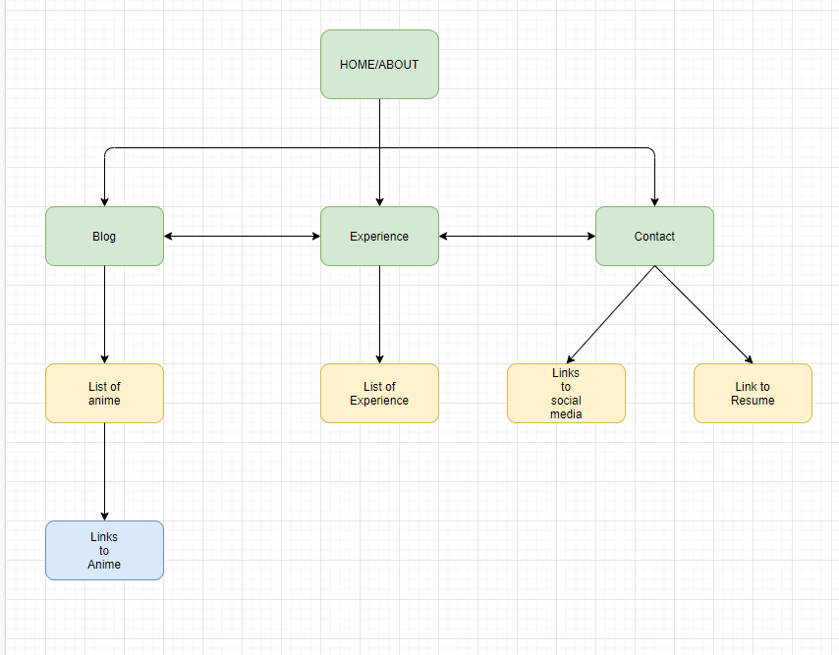
Sitemap

Slide 4
Balsamiq

Slide 5
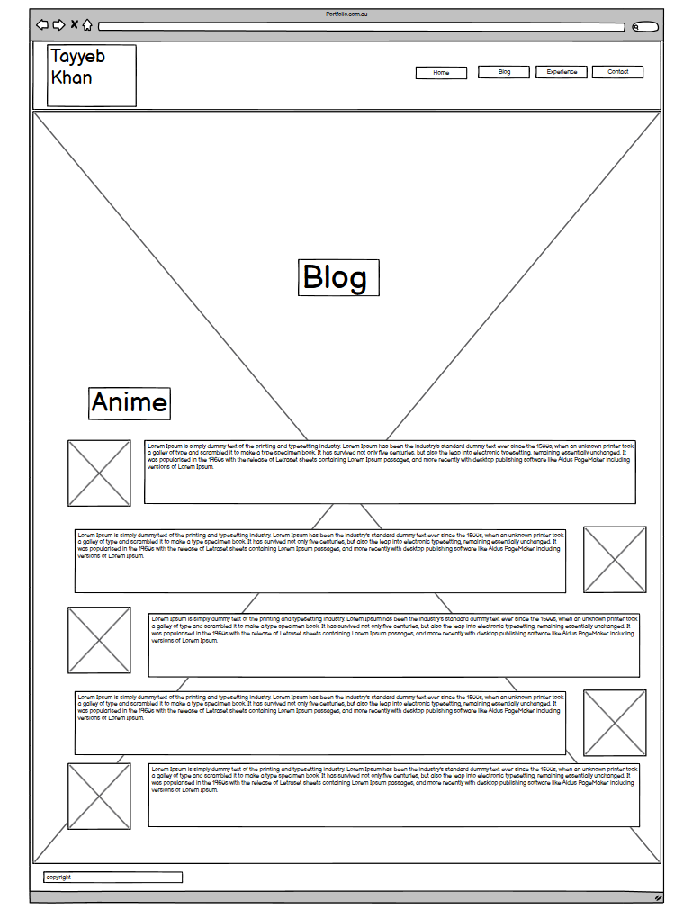
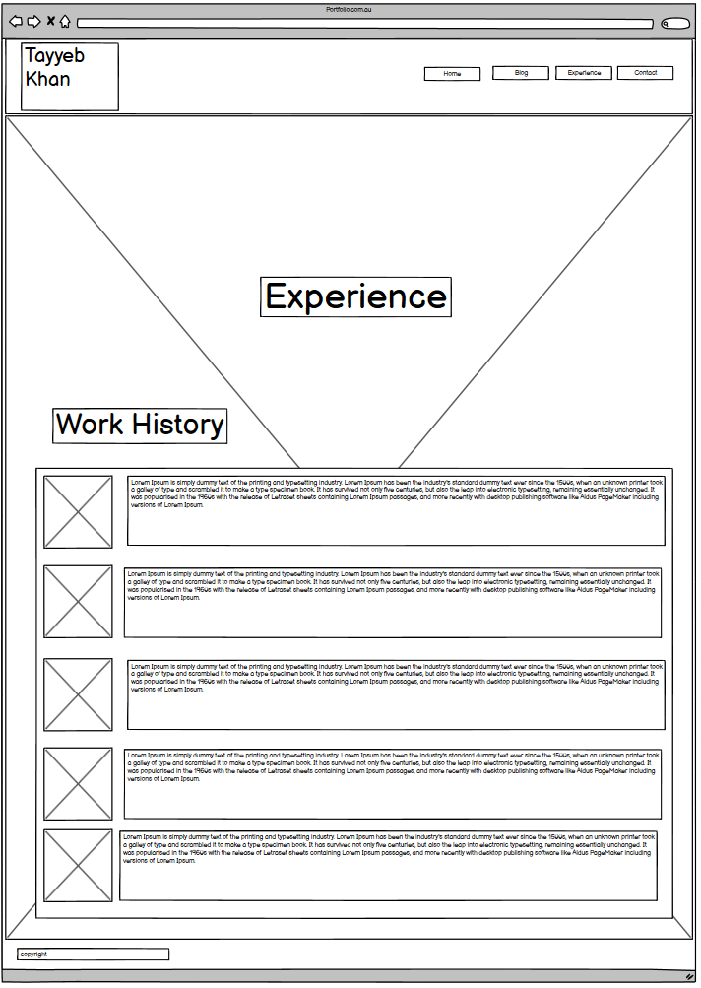
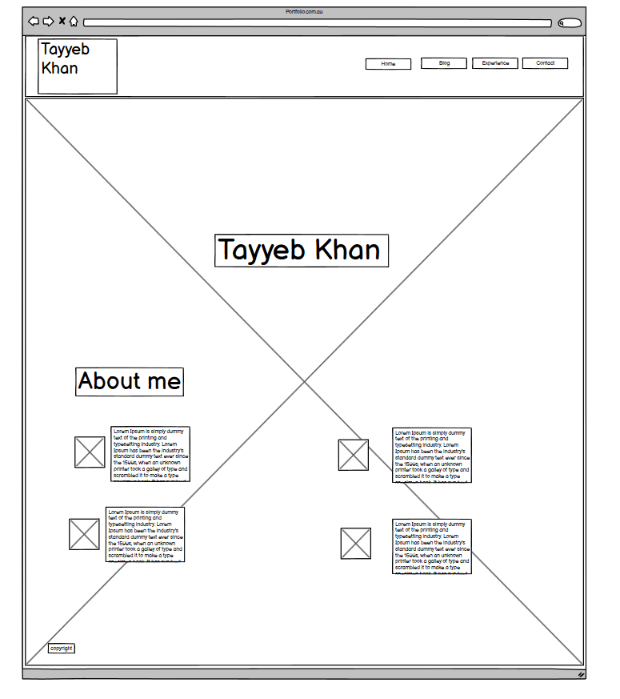
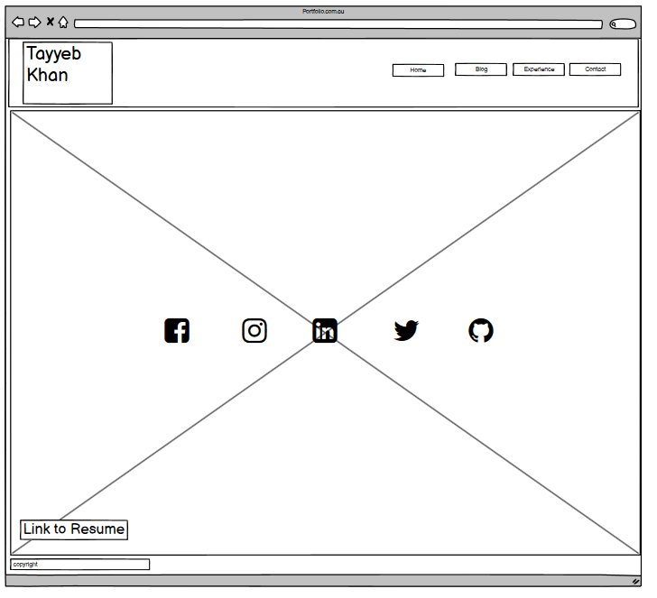
First Draft

Slide 6
Now for the juicy bits
The Home Page
My standard for all the pages to come
The first implementation of the nav bar
The reason you want to see the other pages

Slide 7

Home/Nav/Title

Slide 8
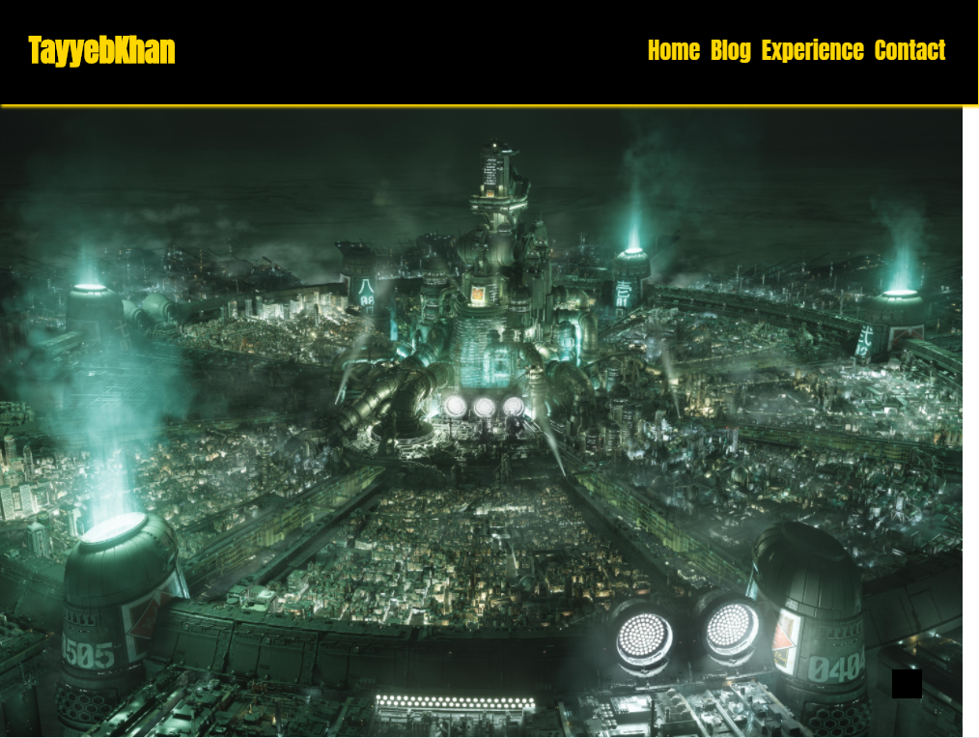
Home/Section

Slide 9
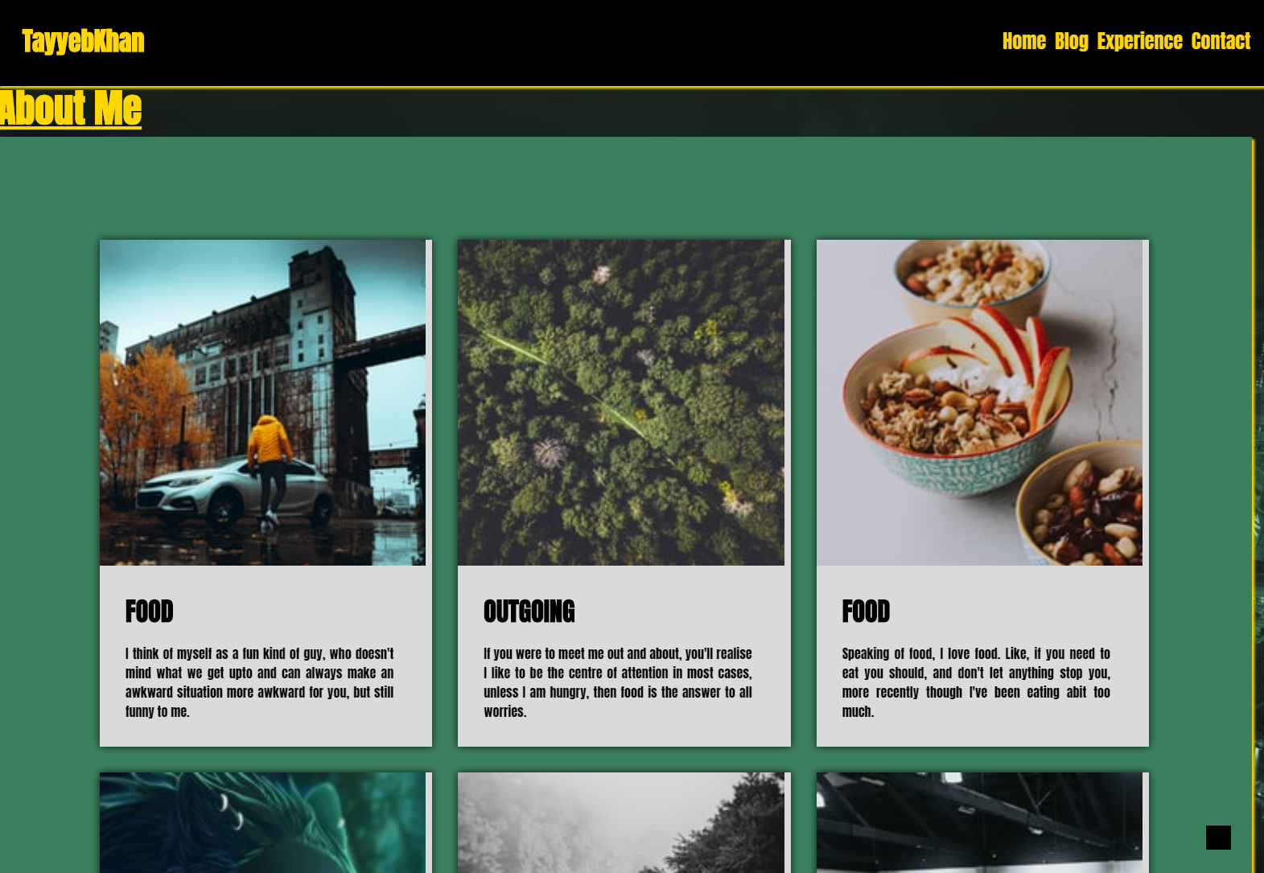
Home/About

Slide 10
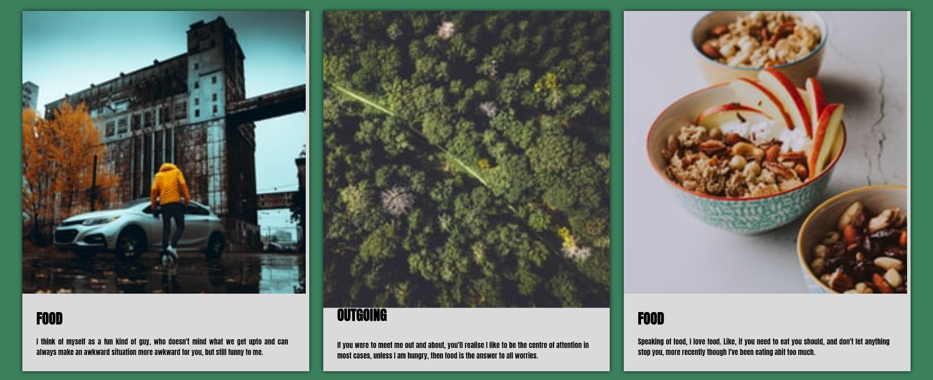
Keyframes

Slide 11

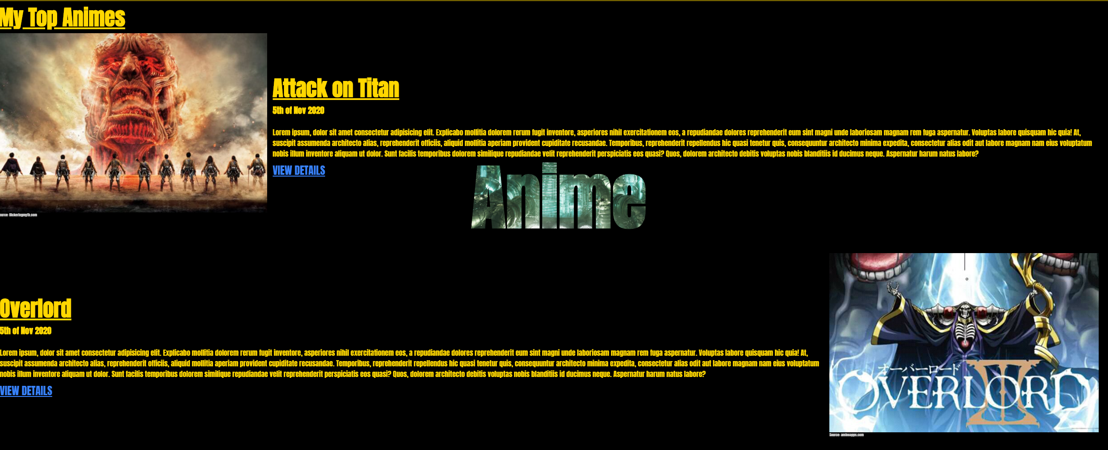
The Blog

Slide 12

Linking my blog

Slide 13

Experience Page

Slide 14
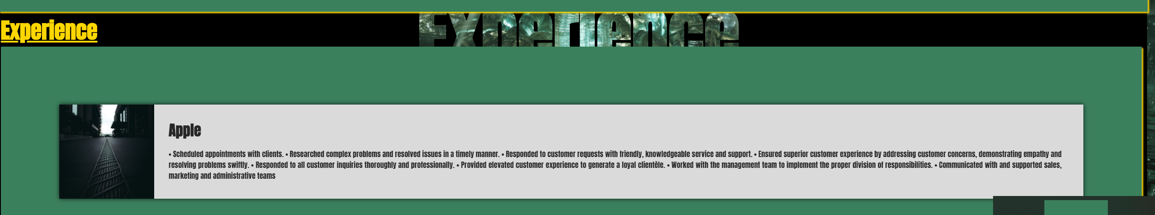
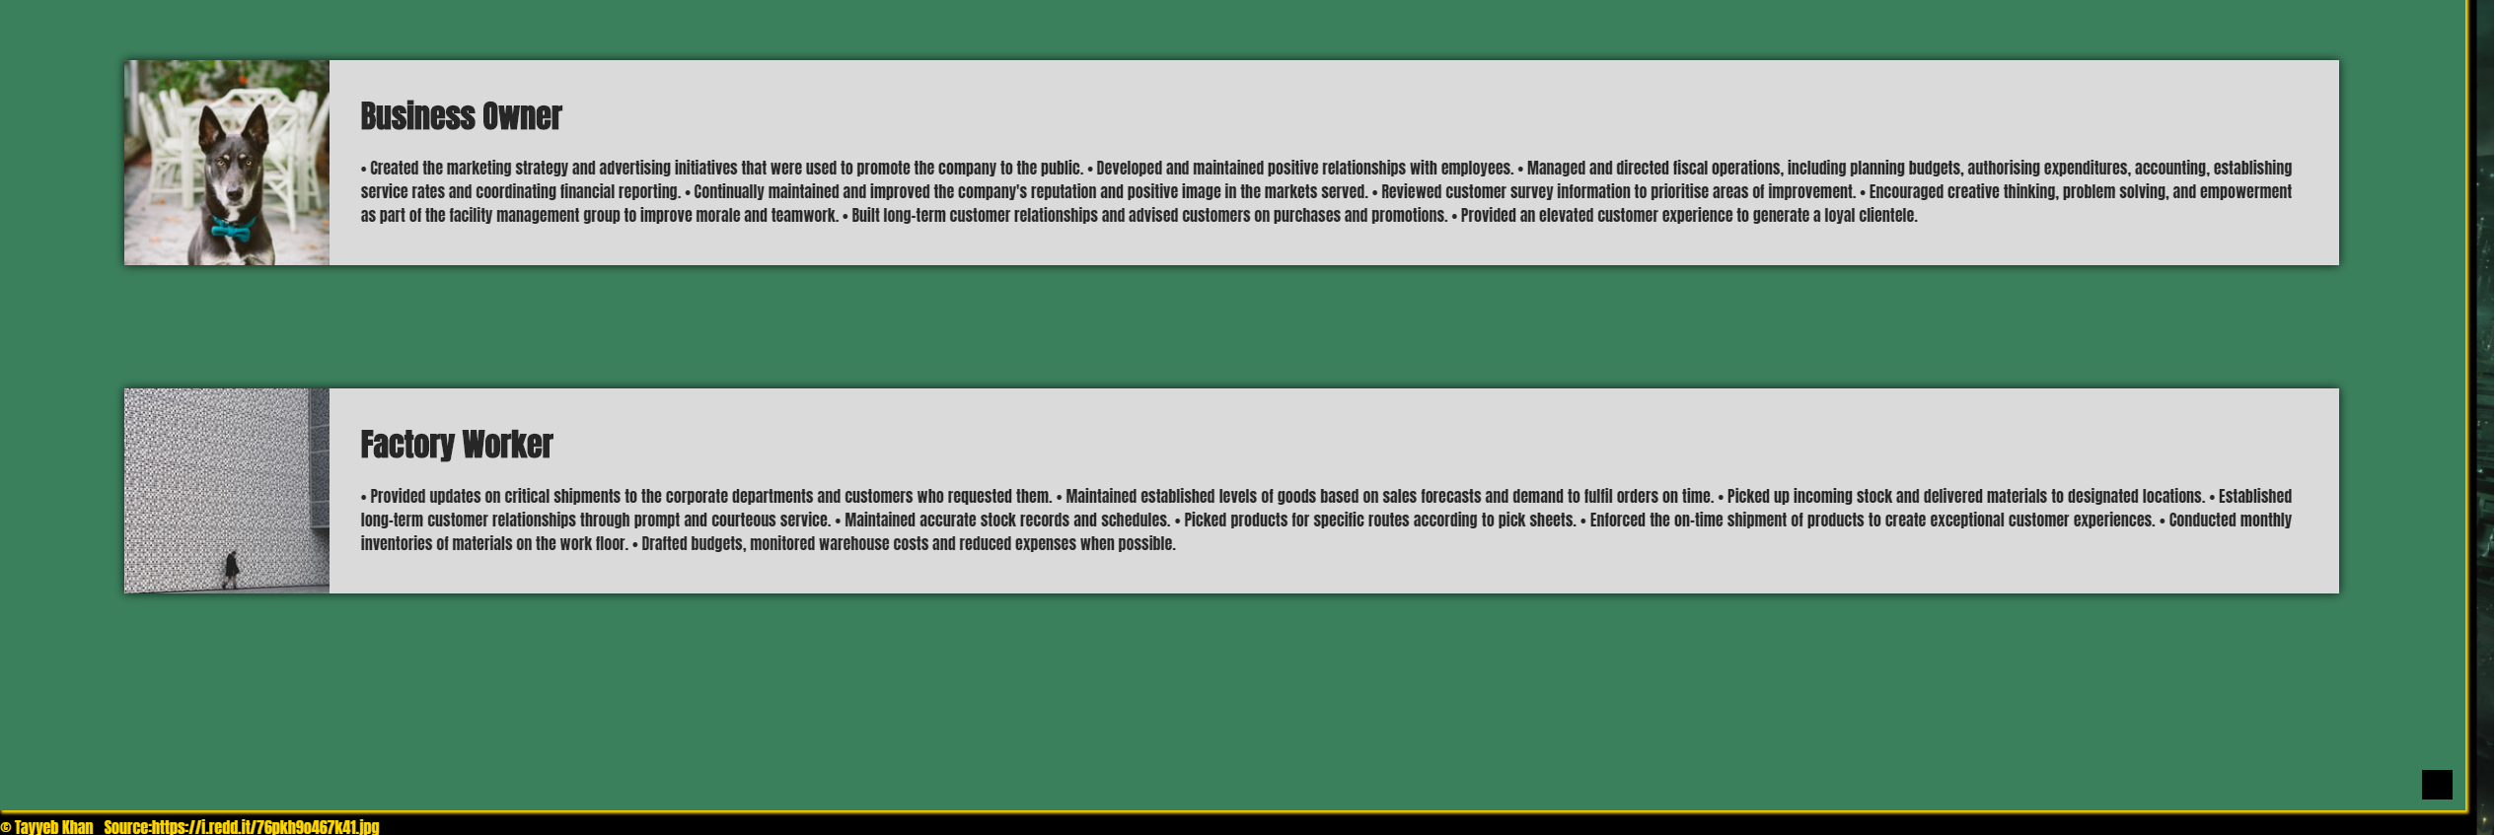
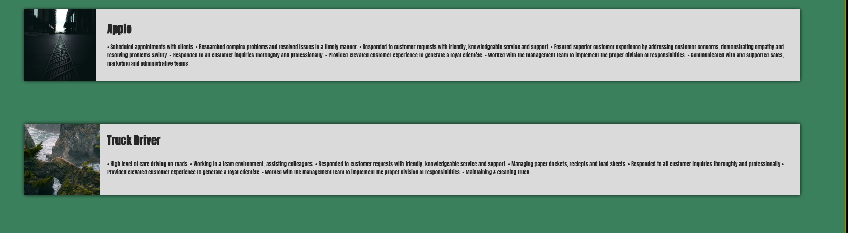
Expereince Page
Something like a resume
Has the same details as a resume
Needs to look Professional
And has keyframes

Slide 15
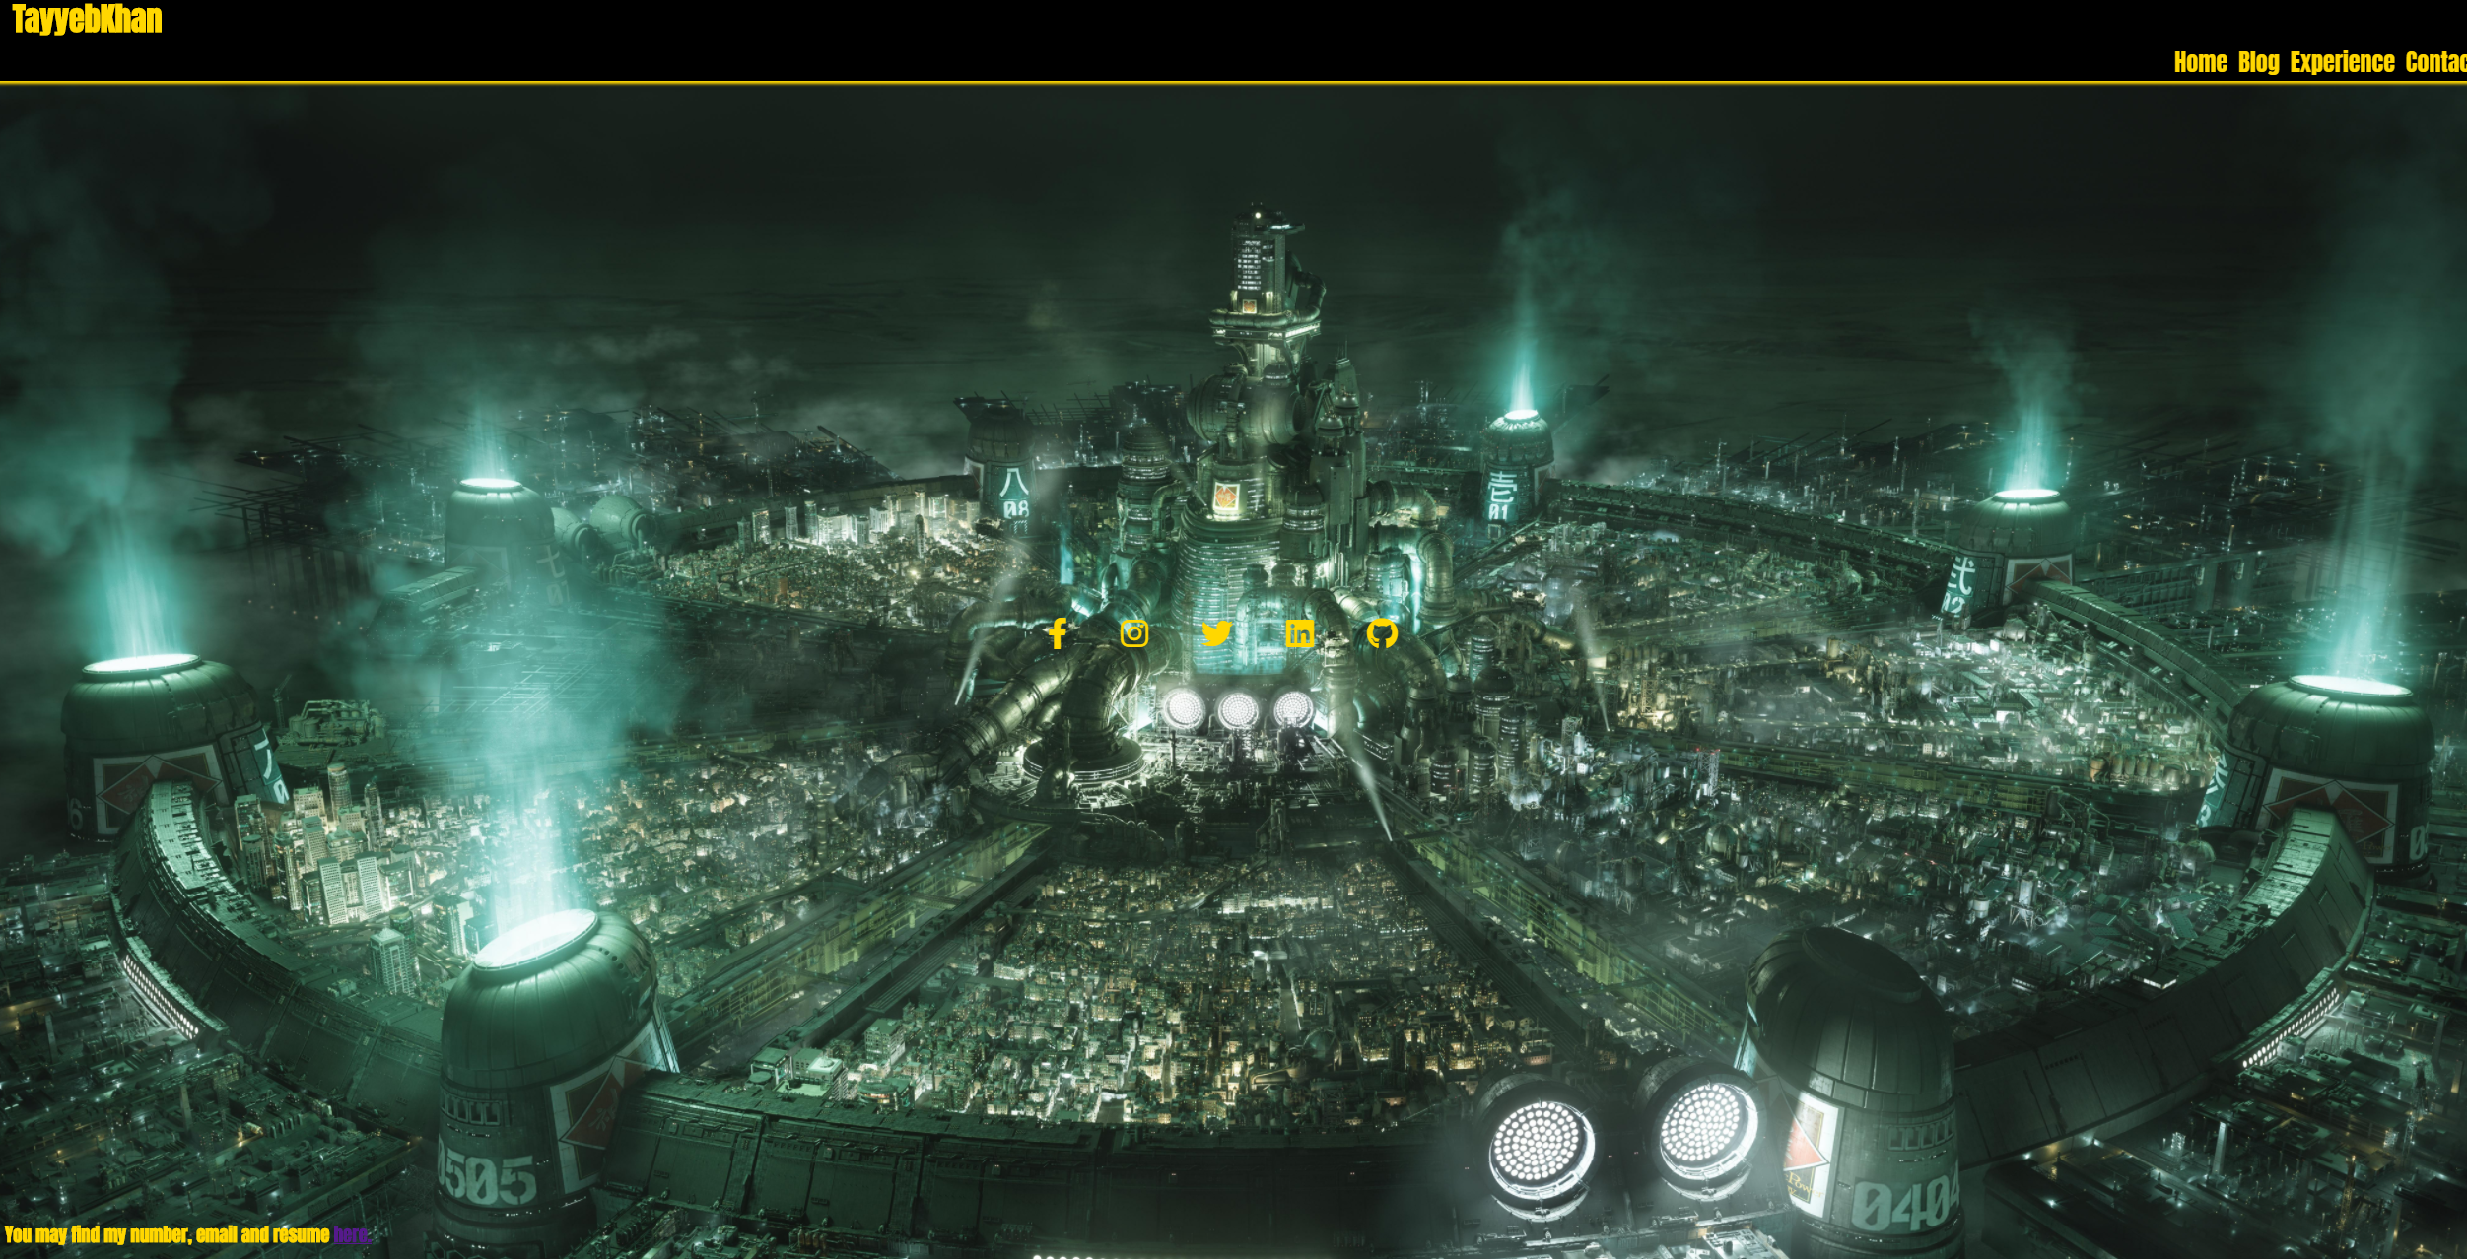

Slide 16
Overall
There is so many amazing portfolio's out there
Can not wait to learn more eg. Java
This is what I got when 2 weeks ago I knew nothing.. Jon Snow

